Slide 1
USRDS Project Xiaohan Cheng Aug 4th , 2021
Notes:
Second-year Master of Engineering in Financial Technology student

Slide 2
Project Purpose
USRDS dataset: The United States Renal Data System (USRDS) is a national data system that collects, analyzes, and distributes information about chronic kidney disease (CKD) and end-stage renal disease (ESRD) in the United States.
Results in 1,244,877 unique patients with 47,184,557 patient months of data.
1/1/2003 ⩽first service date ⩽12/31/2017
The goal is to build a model to classify patients who will live from those who will die
Model: RNN like LSTM and GRU
Notes:
The first column is time to death, so if the time is missing it means the subject is alive.

Slide 3
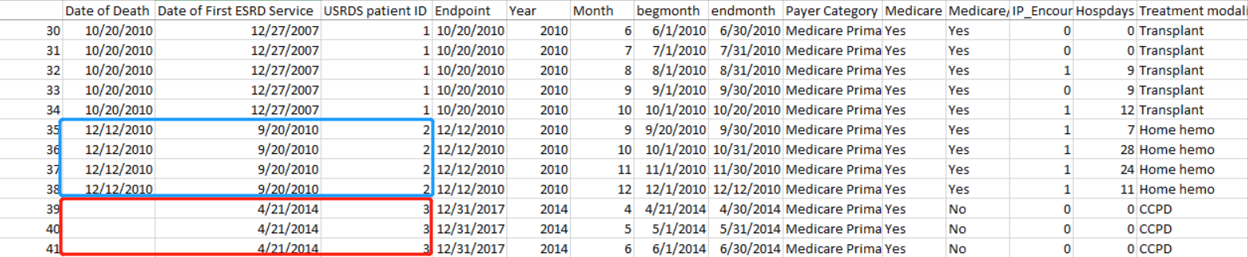
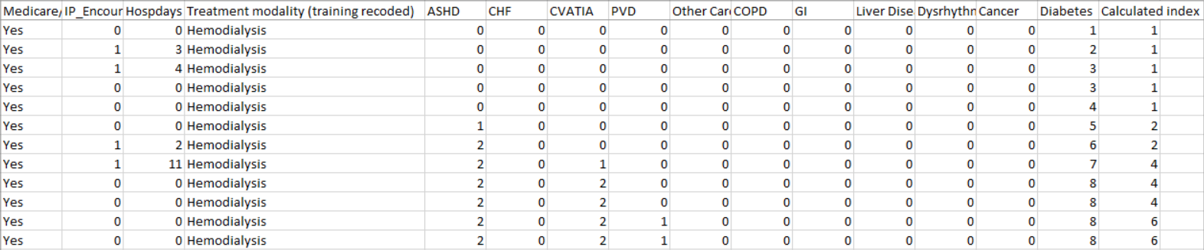
Data description
Notes:
The first column is time to death, so if the time is missing it means the patient is alive.
Each patient has an entry per calendar month, starting with the month of their first service date until the earliest of their death date or 12/31/2017. A month and year variable is created to indicate the patient month being represented, with specific begmonth and endmonth variables created to mark the date the time period begins or ends for an individual.
The dataset has variables for different conditions in the index: ASHD, CHF, CVATIA, PVD, Other cardiac, COPD, GI, Liver disease, dysrhythmia, cancer, and diabetes. These condition specific variables show a number, indicating the number of patient-months a condition has been observed. Any positive number indicates the condition contributes to the overall index score which is also saved in the dataset.

Slide 4
Data Preprocessing
Only use 0.3 million rows
A suitable amount of data is around 0.3 million to 0.5 million.
The result using 0.1 million rows are similar to that using 1 million
Notes:
There are more than 47 million rows. A suitable amount of data is around 0.3 million to 0.5 million.
it is time consuming and I‘m still working on a model with the full dataset.

Slide 5
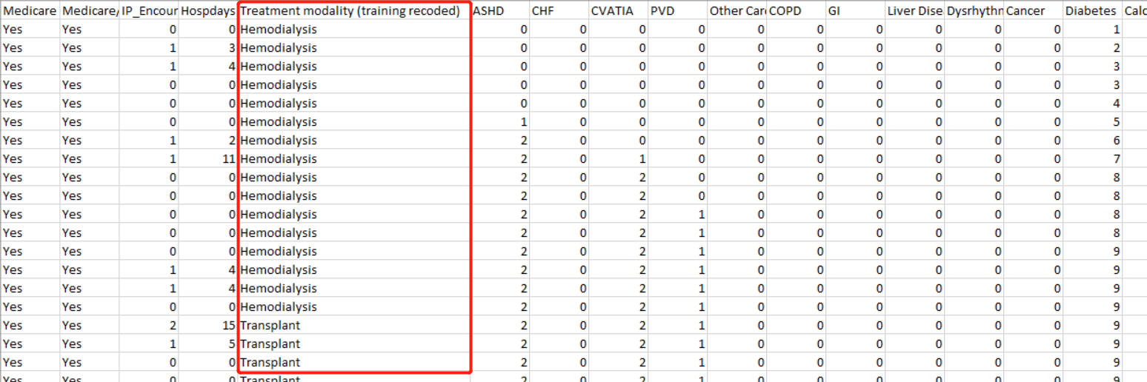
Data Preprocessing
The covariates are all the columns after the medicare plan, they should be either binary or ordinal
OneHot encodes Treatment modality (training recoded)
Only use the last 12 records(rows) for one patient
Notes:
# If there is more than n = 12 entries for one patient, use the last n = 12 entries.
# If there is less than n = 12 entries for one patient, use none of them.

Slide 6
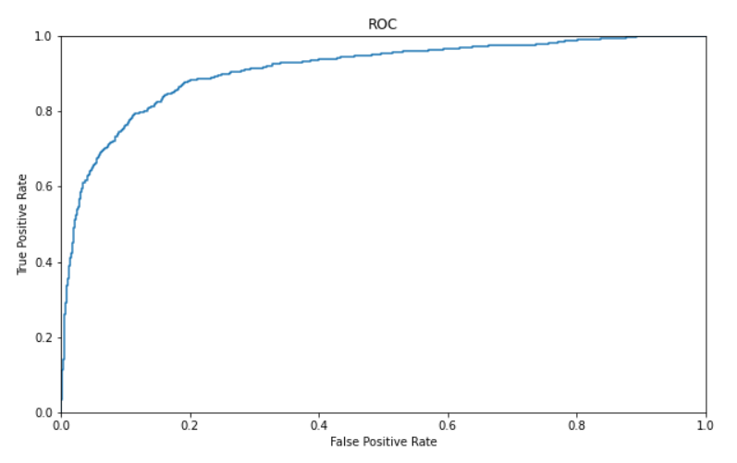
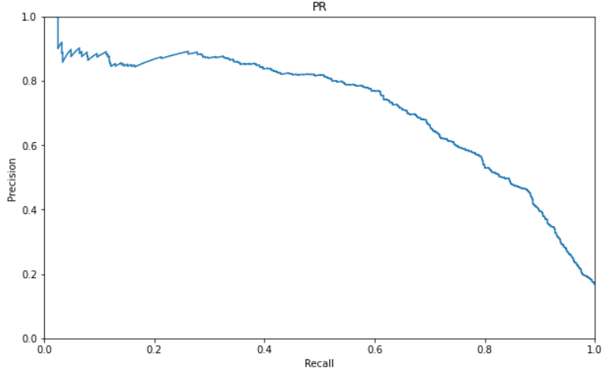
Current Result Using LSTM
Data: 1 million records
Num of patients is 15097
Num of features is 26
Accuracy: 90.7%
AUC = 0.908710
AUPR = 0.719602

Slide 7
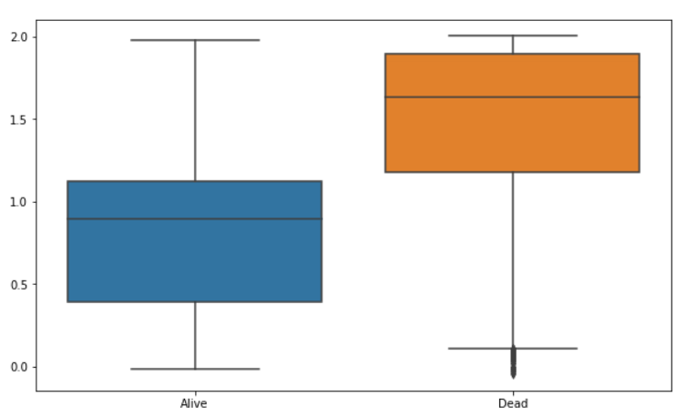
Current Result Using LSTM
Data: 1 million records
Num of Alive: 719
Num of Dead: 3811
Total patient: 4530

Slide 8
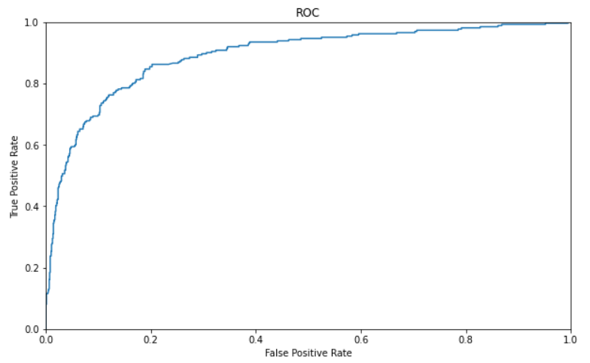
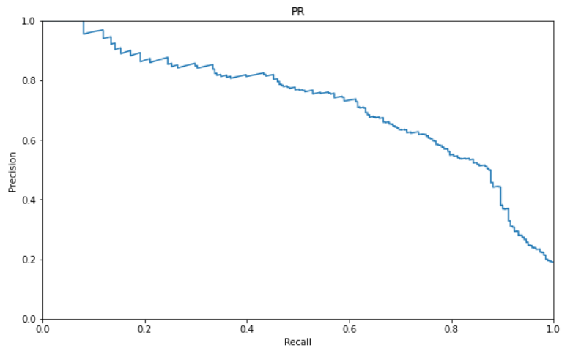
Current Result Using LSTM
Data: 0.3 million records
Num of patients is 4596
Num of features is 26
Accuracy: 87.8%
AUC = 0.891467
AUPR = 0.720770
Notes:
Using 1 million records instead of 0.3M only slightly improves the model. But LSTM with 1M records has slighly lower AUPR, it has better precisions at higher recalls compared to LSTM with 0.3M

Slide 9
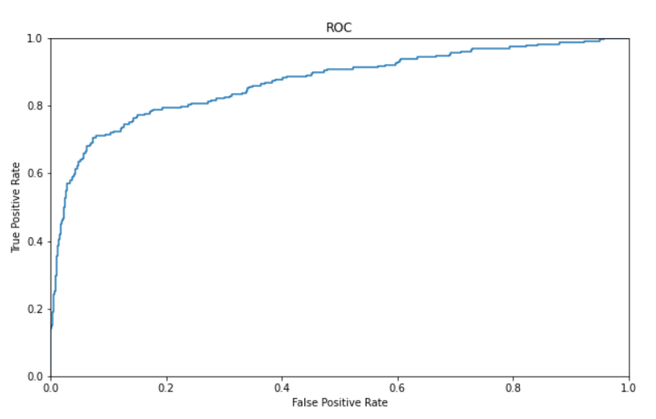
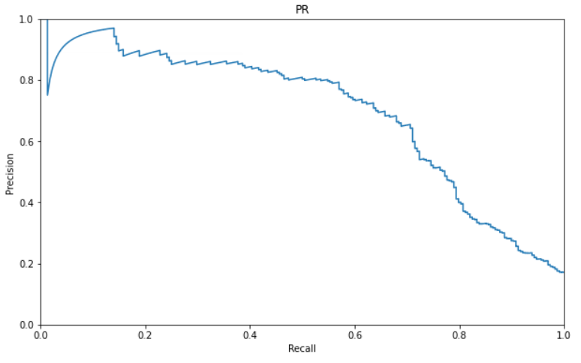
Current Result Using GRU
Data: 0.3 million records
Num of patients is 4596
Num of features is 26
Accuracy: 90.4%
AUC = 0.868306
AUPR = 0.694292

Slide 10
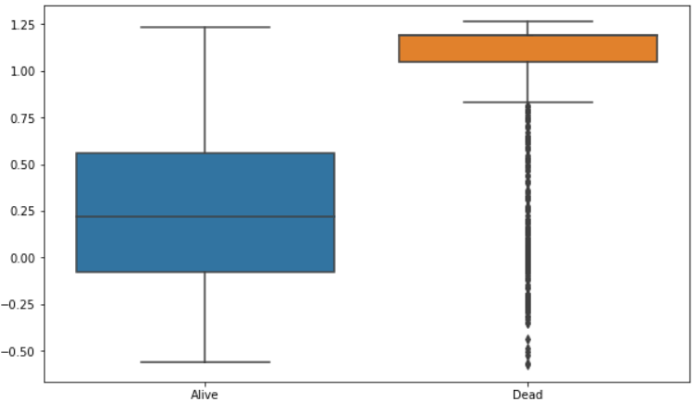
Current Result Using GRU
Data: 0.3 million records
Num of Alive: 228
Num of Dead: 1151
Total patient: 1379
The results of LSTM and GRU are similar, but GRU does not perform better than LSTM.

Slide 11
Future work
Train models to predict patients with less than 12 records.
Try with more than 12 records and transformer-based models
Try to finish the preprocessing part of the whole dataset.
Notes:
if you are predicting dead, your AUC should be > 0.5 and your PR curve should look good as well. As you can see, if you set a threshold at ~2.5, about 50% of the truly dead will be classified as dead and almost everyone alive will be classified as alive.
The current model cannot predict patients with less than 12 records.

